Slide 1
Vehicle
#make:String #model:String #vin:String #year:int | Vehicle brand Model of the vehicle Vehicle Identification Number Year of the vehicle
+ Vehicle() +Vehicle(make:String, model:String, vin:String, year:int) + getMake():String +setMake(String make):void + getModel():String +setModel(String model):void + getVin():String +setVin(String vin):void + getYear():int +setYear(int year):void +toString(): String | Initialize properties to Java default Each property should be separated by line separator in the given order

Slide 2
Automobile
-hybrid:Boolean -maxPassengers:int -trunkSpace:float | Hybrid type Maximum number of passenger Space of trunck
+ Automobile() +Automobile(hybrid:boolean, maxPassengers:int, trunkSpace:float) +getHybrid():Boolean +getMacPassengers():int +getTrunkSpace():float +setHypbrid(hybrid:Boolean):void +setMaxPassengers(maxPassengers:int) :void +setTrunkSpace(trunkSpace:float):void +toString(): String | Initialize properties to Java default Each property should be separated by line separator in the given order

Slide 3
Van
#clearanceHeight:float #numWindows:int | Hieght of van clearance number of windows
+ Van() +Van(clearanceHeight:float ,numWindows:int) +getClearanceHeight():float +getNumWindows():int +setClearanceHeight(learanceHeight:float):void +setNumWindows(numWindows:int):void +toString(): String | Initialize properties to Java default Each property should be separated by line separator in the given order

Slide 4
PassengerVan
-numSeatRows:int - maxPassengers:int -dvdPlayer:Boolean | Hieght of van clearance number of windows
+ PassengerVan() +PassengerVan(numSeatRows:int, maxPassengers:int, dvdPlayer:Boolean) + getNumSeatRows():int + getMaxPassengers():int +getDvdPlayer():Boolean +setNumSeatRows (numSeatRows:int)void + setMaxPassengers (maxPassengers:int):void +setDvdPlayer (dvdPlayer:Boolean):void +toString(): String | Initialize properties to Java default Each property should be separated by line separator in the given order

Slide 5
CargoVan
- maxLoad:float - cargoArea:float | Cargovan maximum load Area of the cargo
+ CargoVan() +CargoVan(maxLoad:float , cargoArea:float) +getMaxLoad():float - getCargoArea():float +setMaxload(maxLoad:float ):void +setCargoArea(cargoArea:float):void +toString(): String | Initialize properties to Java default Each property should be separated by line separator in the given order

Slide 6
Fleet
-fleetName:String -fleetList:ArrayList<Vehicle> | Cargovan maximum load Arraylist of Vehicle objects
+ Fleet() +Fleet(fleetName:String) +loadFleet( inputFileName:String ) :void +saveFleet( outputFileName:String) :void +getFleetName():String +setFleetName(fleetName:String):void +getVehicleList( vehicleClass:Class):ArrayList<Vehicle> + setFleeList(ArrayList<Vehicle> fleeList):void +addVehicle(v:Vehicle):void +getNumVehicles():int +toString(): String | Initialize properties to Java default Constructor with parameter will be used to instantiate fleetList Use the input file to populate the Fleet object. Save the fleet data in the given output file using the input file format. Return an ArrayList with all the Vehicles that match the given parameter. Return a string with all the Fleet data formatted consistently with the input file format .

Slide 7
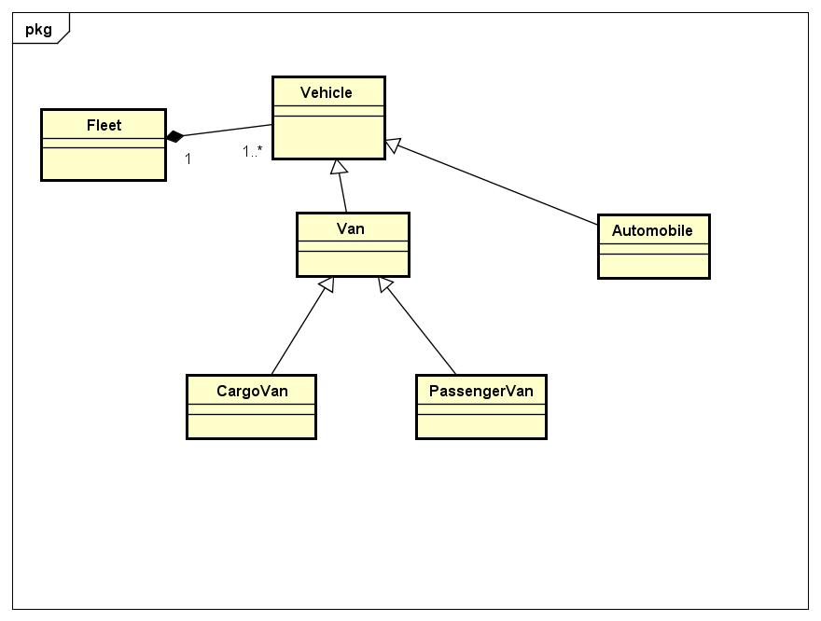
UML Domain

